Slide 1
DocFlow
AI-powered document processing platform.

Slide 2
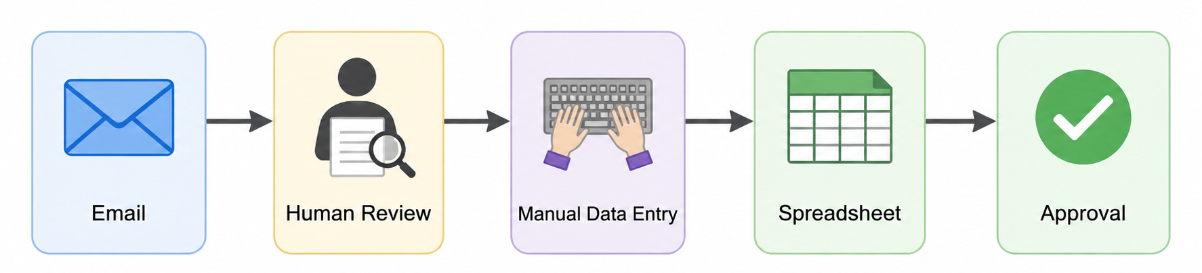
Many documents!
Many types of documents!
Candidate CVs
Invoices
Contracts
  Problems!
  slow
  expensive
  inconsistent
  impossible to scale efficiently

Slide 3
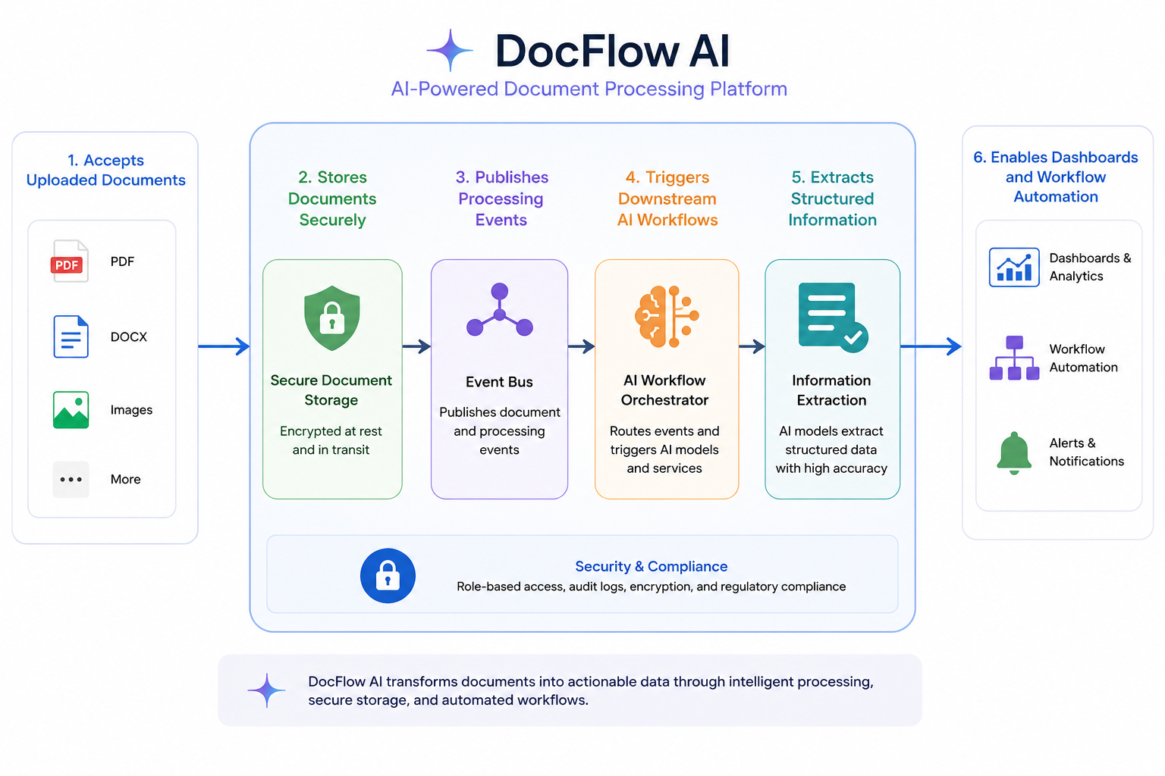

Slide 4
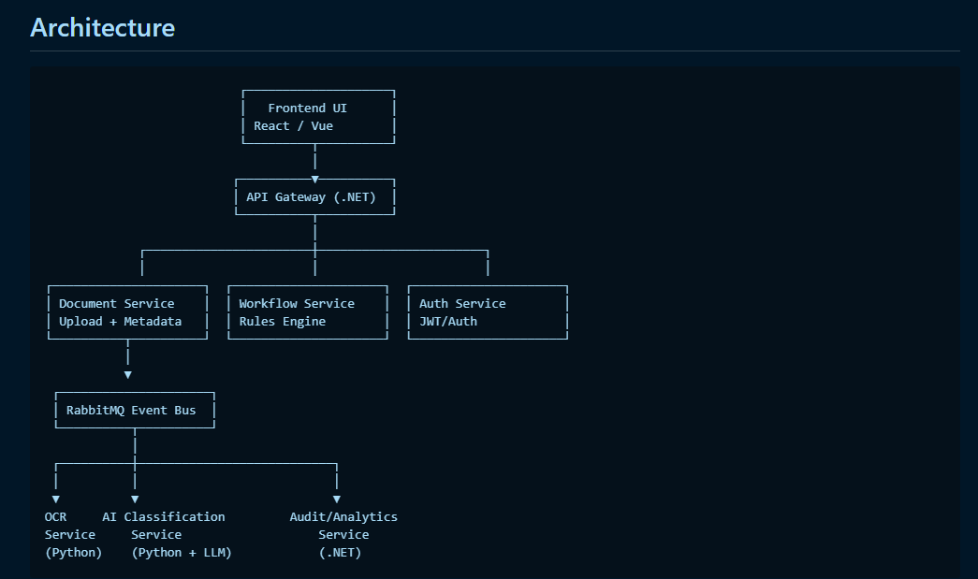
Upload File
Blob Storage
AI Services

Slide 5
Coming soon - UI
Swagger
Document Service Api
Upload file
doc-uploaded
Blob Storage
doc-processed
AI Service

Slide 6
Demo

Slide 7
Tech spec used
IDEs
  VS code
  Visual Studio
Containerization of microservices
  Docker containers (Docker desktop (on Windows))
  RabbitMQ
  Azurite (Blob Storage Solution)
Blob Explorer
  Microsoft Azure Storage Explorer
AI tools used
  ChatGPT online
  Claude Code
  GitHub Copilot in VS code

Slide 8
Roadmap for running the app
Development
  Docker Desktop (on Windows)
  Azurite (Blob)
Stage/Live
  Azure
  Cross the bridge

Slide 9
Development Environment (dev computer)

Slide 10
Live environment (Azure)

